Slide 1
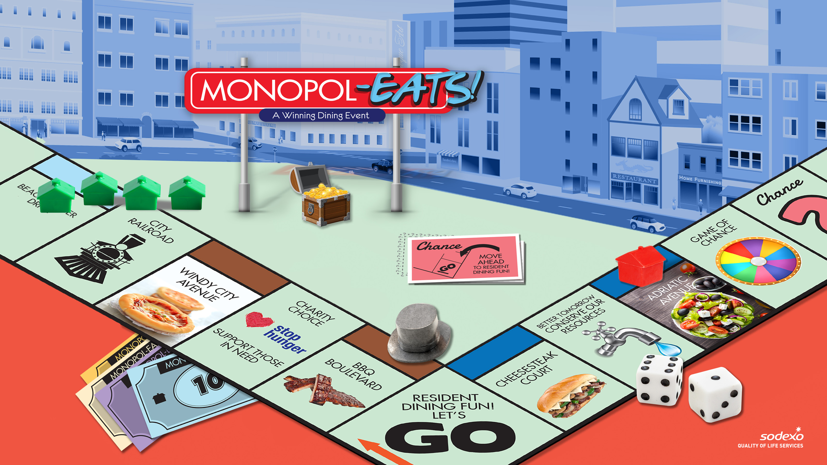

Slide 2
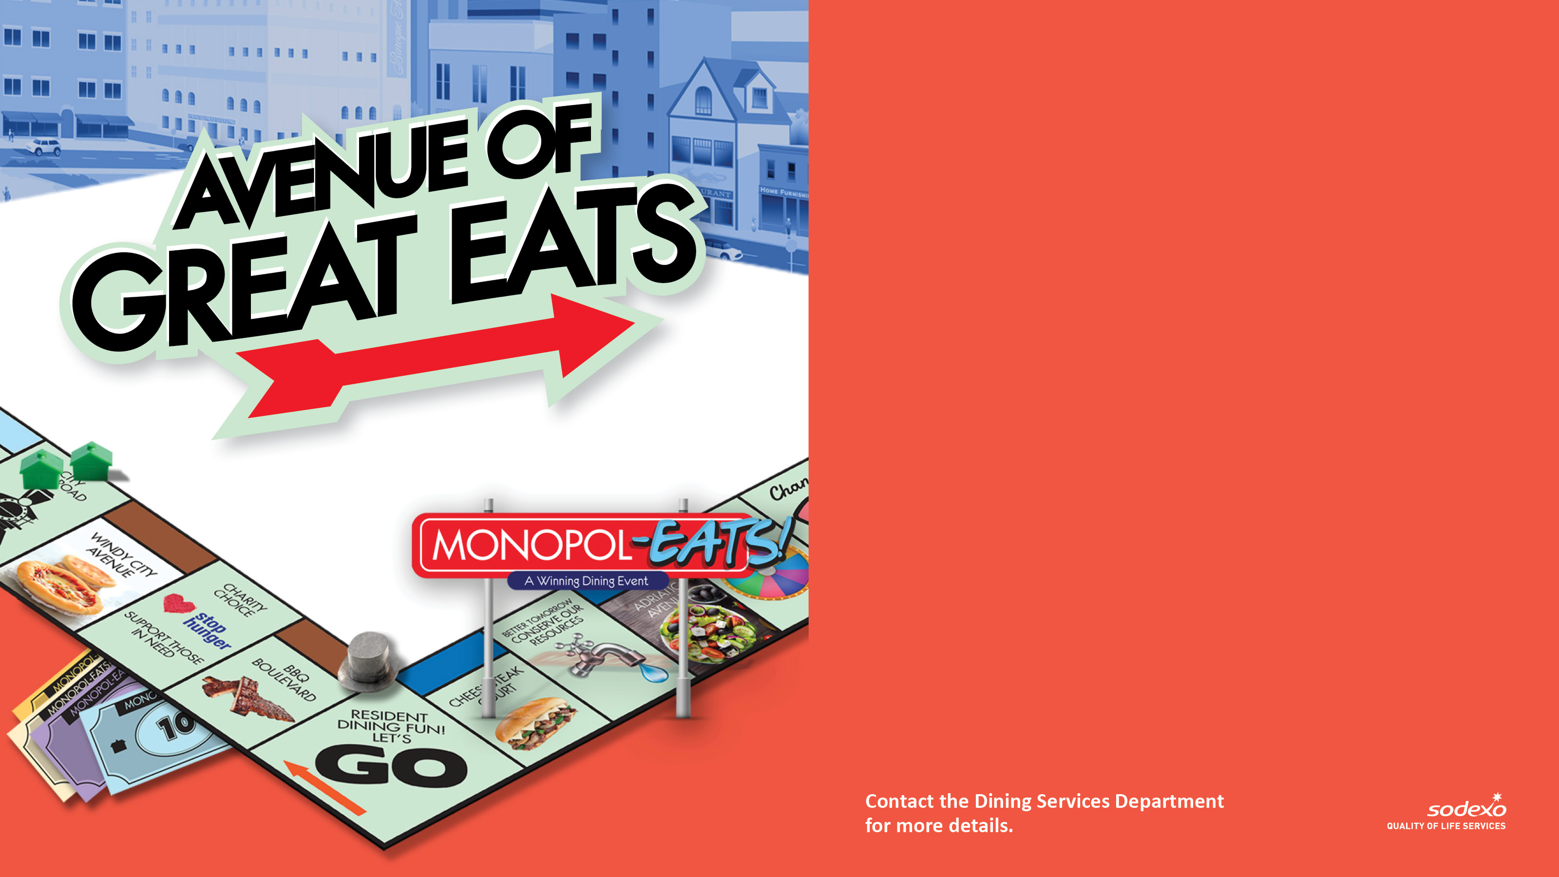
STROLL THE STREETS
OF FUN EATS
Join us for a sampling of classic
foods based on properties from the
iconic real estate board game. The
fun all starts on [INSERT DAY/DATE] at [INSERT TIME]. Here’s a glimpse of
what’s in store:
[INSERT EVENT FOOD STATIONS]
[INSERT MENU ITEMS]

Slide 3

SHOW OFF YOUR
ARTISTIC ABILITY
Join us for an inspiring art-themed
talent party on [INSERT DAY/DATE]
at [INSERT TIME]. Here’s a glimpse
of what’s in store:
[INSERT EVENT HIGHLIGHTS]
[INSERT MENU ITEMS]

Slide 4

HELPING THOSE IN NEED
Help those in need in our community
by donating non-perishable food
items during a special Monopol-EATS!
Community outreach event held in
the [INSERT LOCATION] from [INSERT
START DATE] to [INSERT END DATE].

Slide 5

SPIN TO WIN SOME
GREAT PRIZES
Join us for a chance to win some
terrific prizes during our Monopol-EATS!
Celebration on [INSERT DAY/DATE] in the
[INSERT LOCATION].
[INSERT PRIZES YOU HAVE PLANNED]
[INSERT MENU ITEMS YOU HAVE PLANNED]

Slide 6

BE ON THE LOOKOUT
FOR VALUABLE PRIZES
Join in our prize-filled scavenger hunt
that gives you many ways to win during our
Monopol-EATS! Event on [INSERT DAY/DATE]
in the [INSERT LOCATION]!
[INSERT EVENT DETAILS]
[INSERT MENU SPECIALS YOU HAVE PLANNED]

Slide 7

DRESS THE PART FOR A
GAME-THEMED SELFIE
Check out the fabulous photo booth
and fun props you can use to take a
fun selfie in the [INSERT LOCATION]
on [INSERT START DAY/TIME].

Slide 8
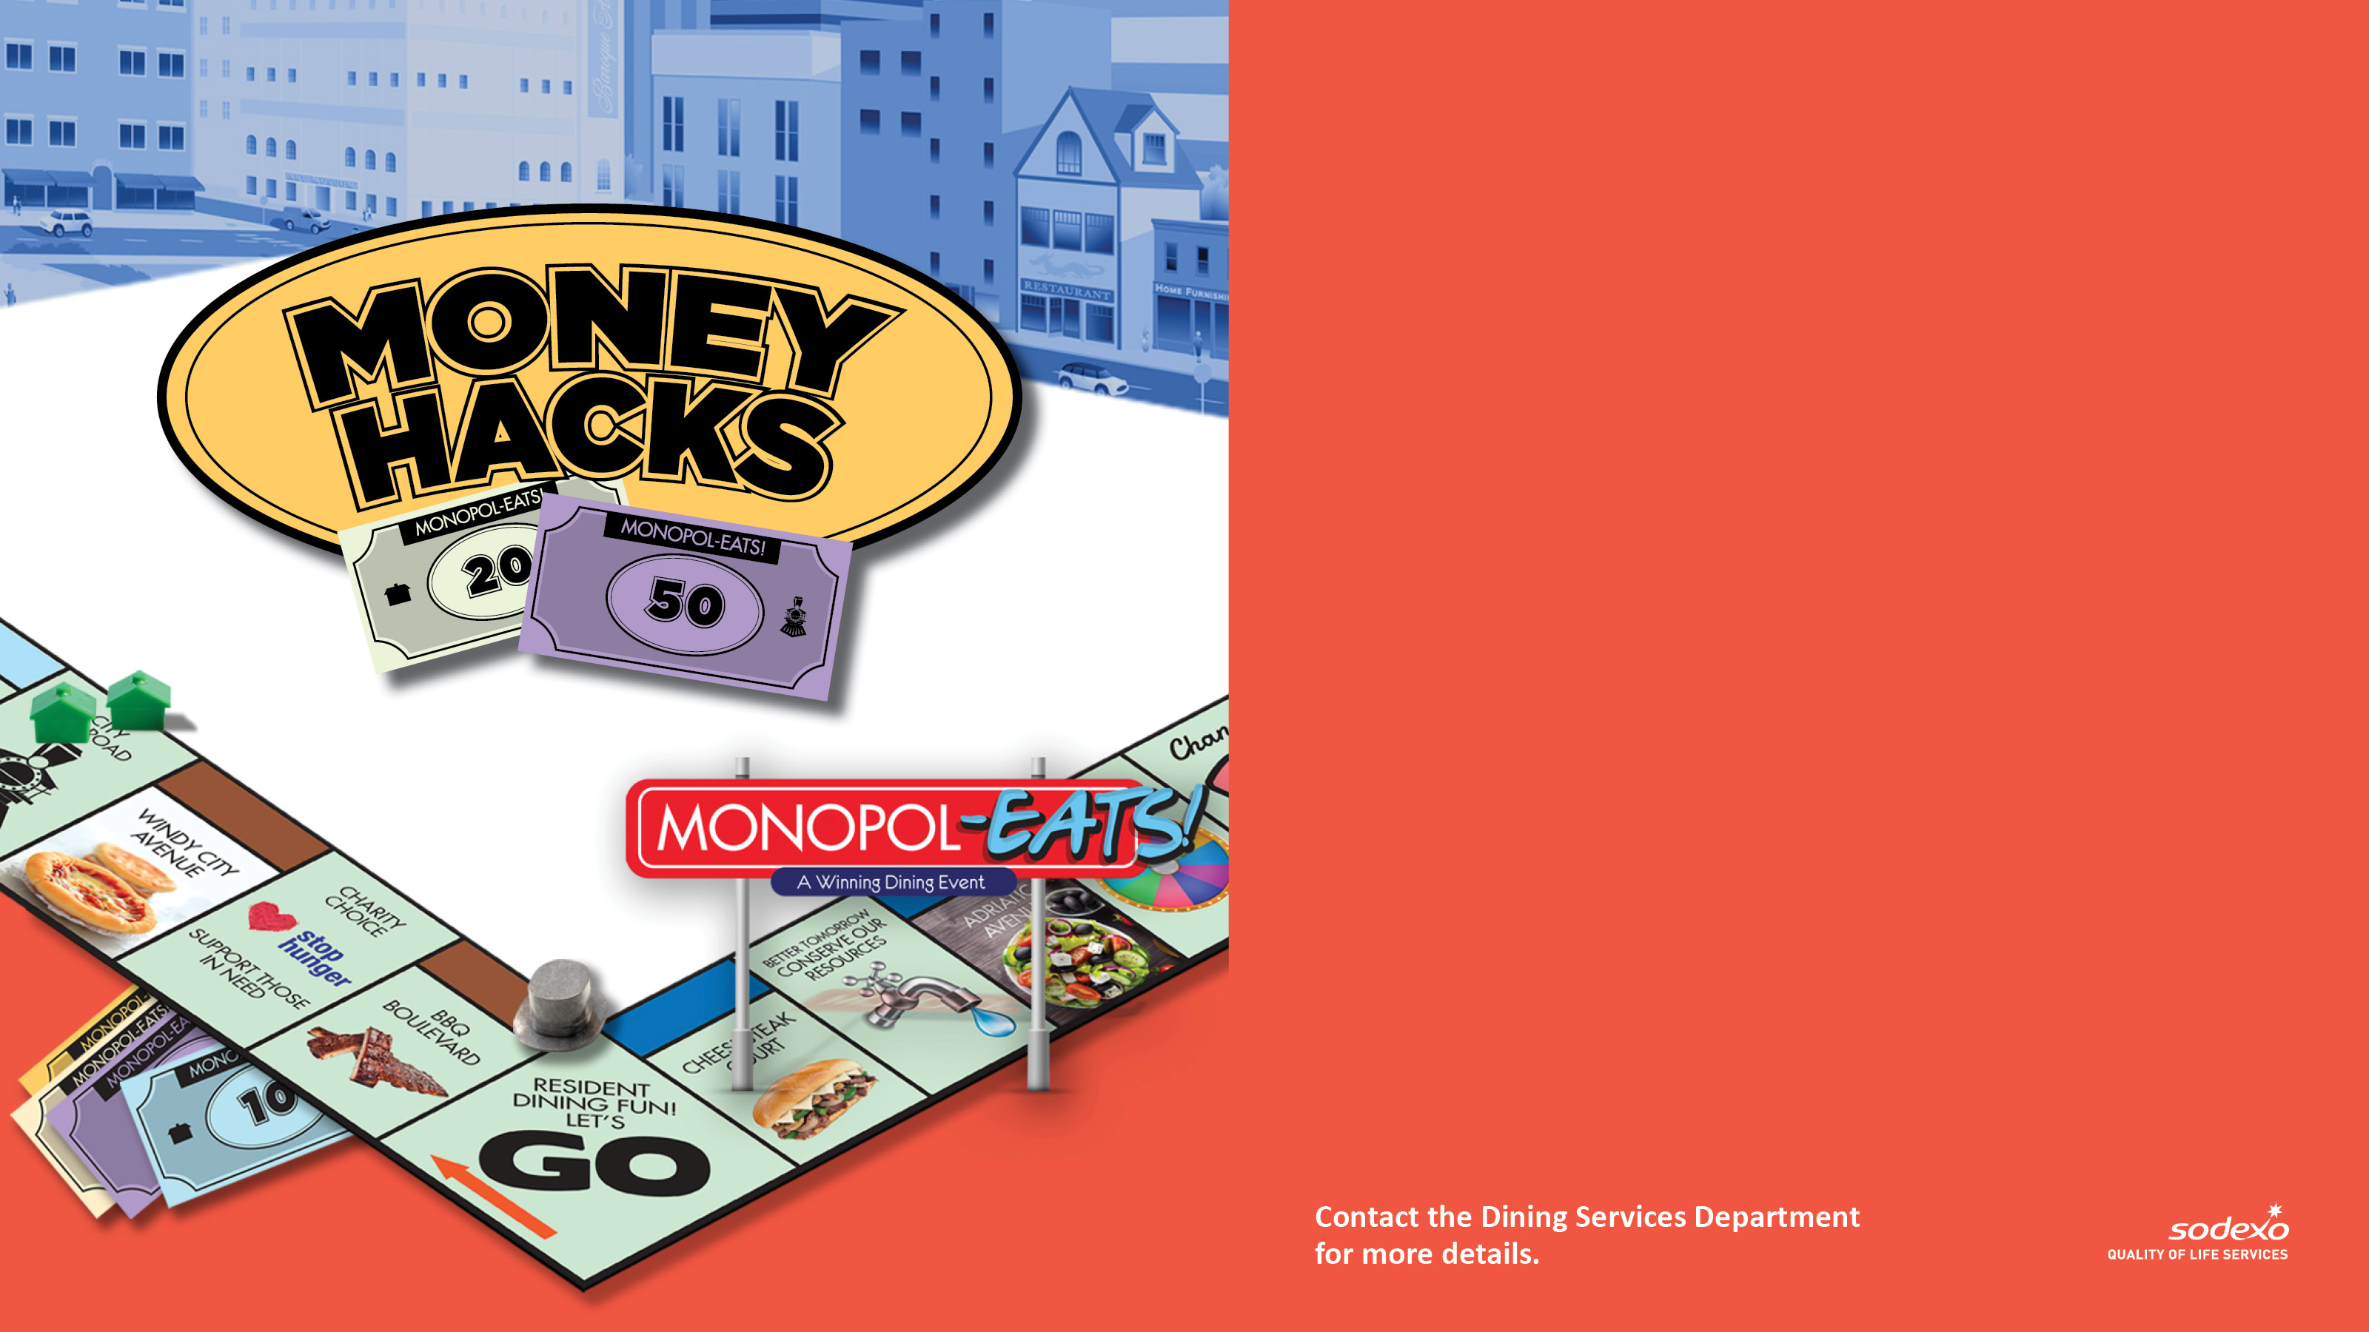
LEARN WAYS TO SAVE AND
A WHOLE LOT MORE!
Visit the [INSERT LOCATION] on [INSERT DAY/DATE to get valuable money-saving
tips and cost-cutting suggestions from
[INSERT PARTICIPATING PARTNERS].
Learn some great tips on stretching
your dollar!
[INSERT EVENT DETAILS]
[INSERT MENU SPECIALS YOU HAVE PLANNED]

