Slide 1
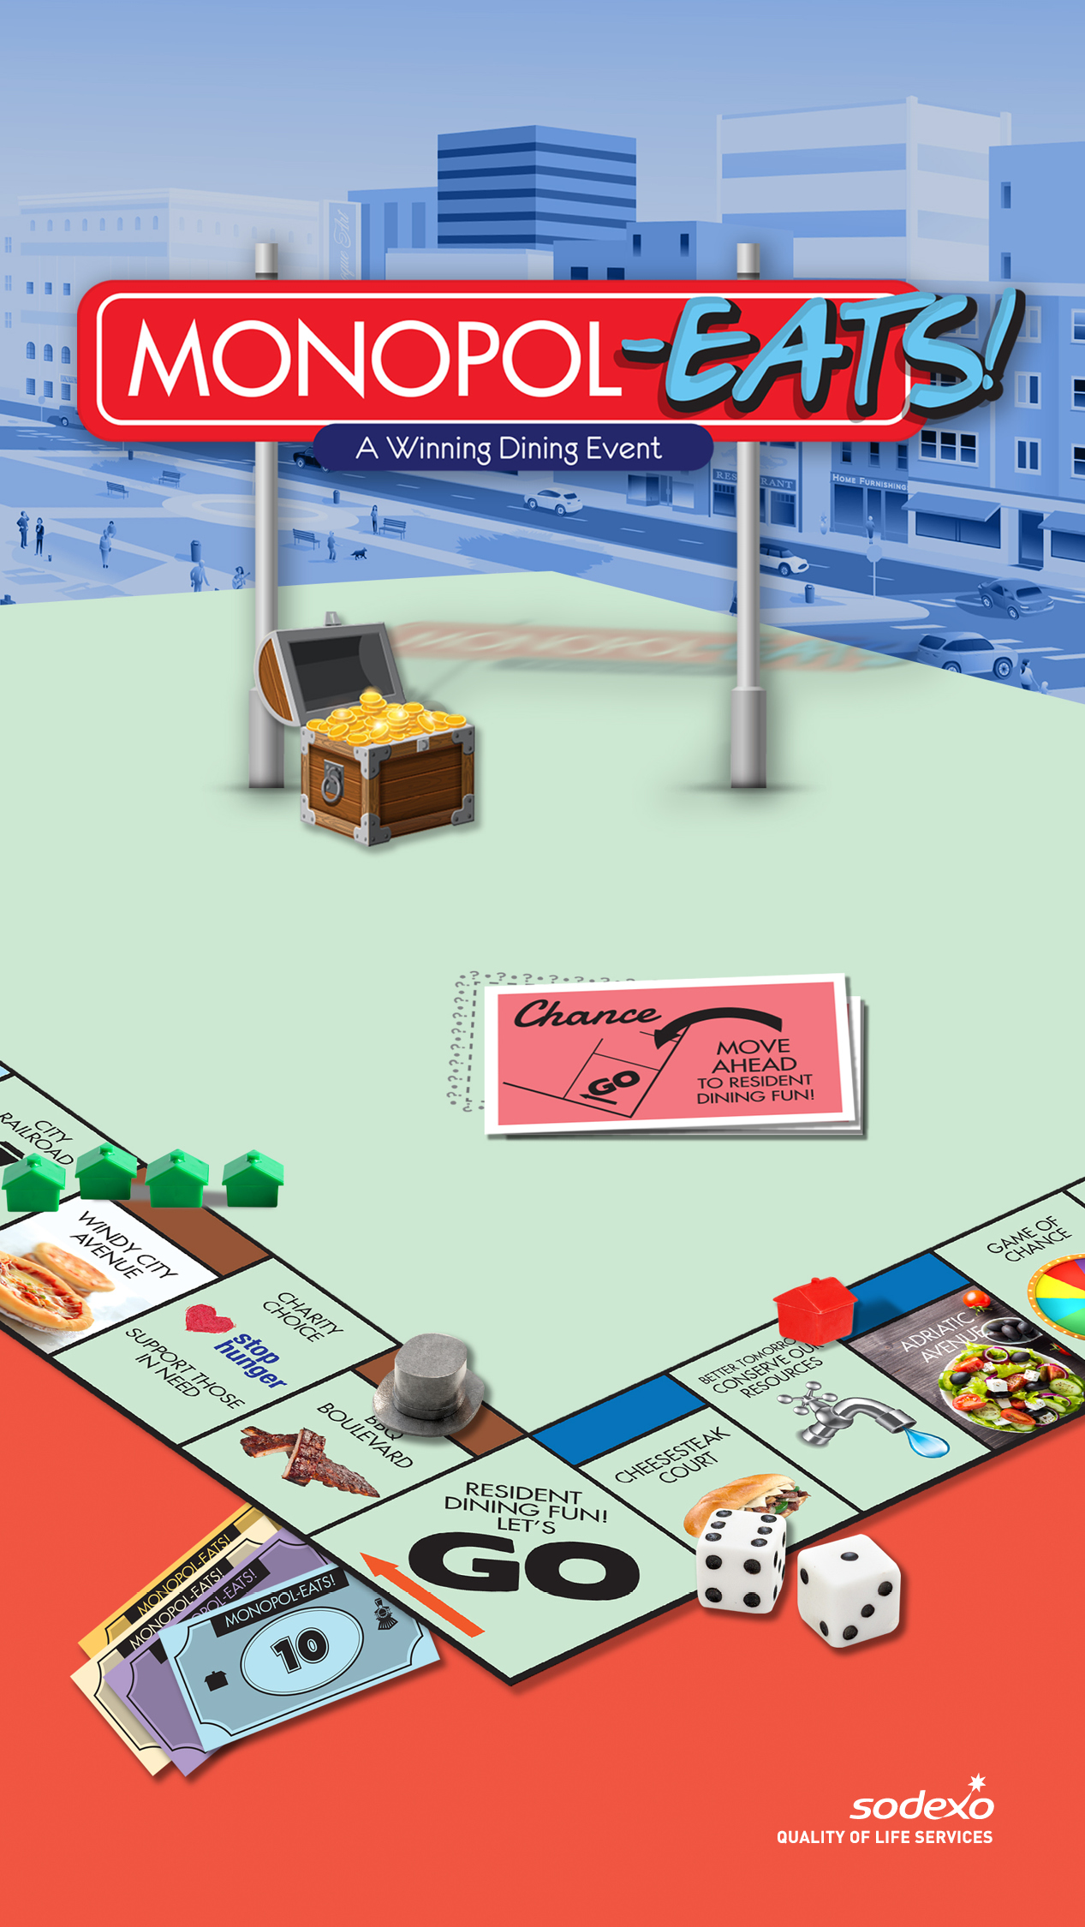

Slide 2

STROLL THE STREETS OF FUN EATS
Join us for a sampling of classic foods based on
properties from the iconic real estate board
game. The fun all starts on [INSERT DAY/DATE] at
[INSERT TIME]. Here’s a glimpse of what’s in store:
[INSERT EVENT FOOD STATIONS]
[INSERT MENU ITEMS]

Slide 3
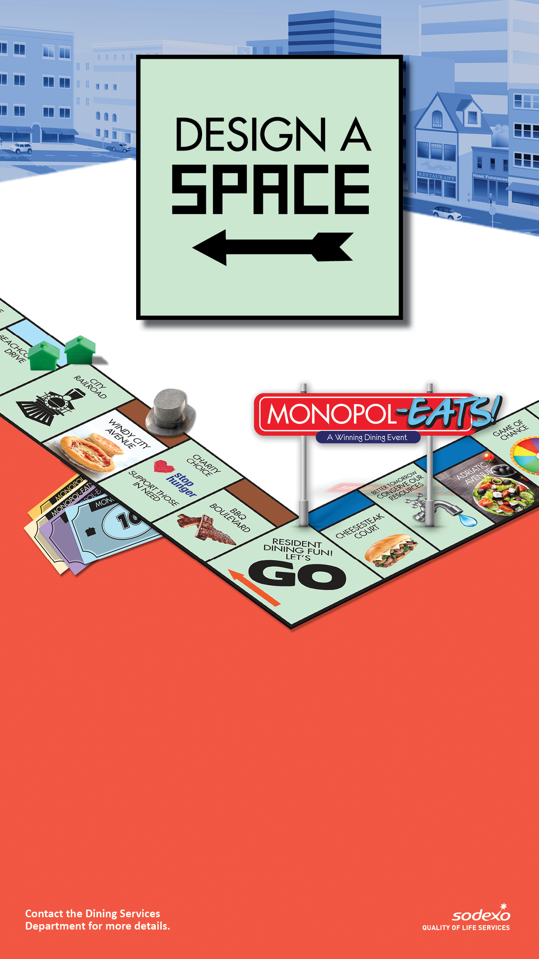
SHOW OFF YOUR ARTISTIC ABILITY
Join us for an inspiring art-themed talent party
on [INSERT DAY/DATE] at [INSERT TIME]. Here’s a
glimpse of what’s in store:[INSERT EVENT HIGHLIGHTS]
[INSERT MENU ITEMS]

Slide 4

HELPING THOSE IN NEED
Help those in need in our community by donating
non-perishable food items during a special Monopol-EATS! community outreach event held in the [INSERT LOCATION]
from [INSERT START DATE] to [INSERT END DATE].

Slide 5

SHOW OFF YOUR ARTISTIC ABILITY
Join us for an inspiring art-themed talent party on
[INSERT DAY/DATE] at [INSERT TIME]. Here’s a glimpse
of what’s in store:
[INSERT EVENT HIGHLIGHTS]
[INSERT MENU ITEMS]

Slide 6

BE ON THE LOOKOUT FOR
VALUABLE PRIZES
Join in our prize-filled scavenger hunt that gives
you many ways to win during our Monopol-EATS! event
on [INSERT DAY/DATE] in the [INSERT LOCATION]!
[INSERT EVENT DETAILS]
[INSERT MENU SPECIALS YOU HAVE PLANNED]

Slide 7

DRESS THE PART FOR
A GAME-THEMED SELFIE
Check out the fabulous photo booth and fun
props you can use to take a fun selfie in the [INSERT
LOCATION] on [INSERT START DAY/TIME].

Slide 8
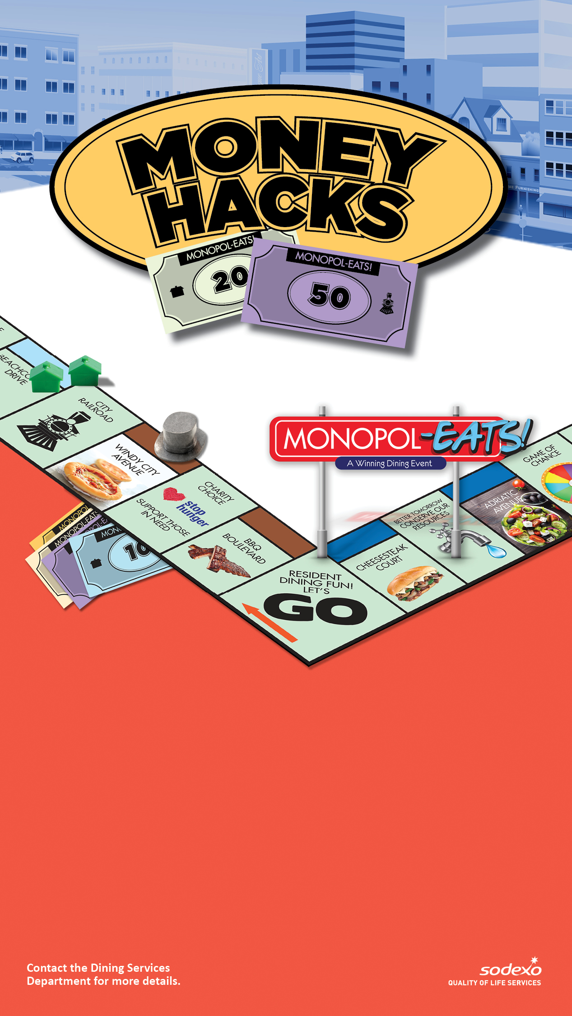
LEARN WAYS TO SAVE AND
A WHOLE LOT MORE!
Visit the [INSERT LOCATION] on [INSERT DAY/DATE]
to get valuable money-saving tips and cost-cutting
suggestions from [INSERT PARTICIPATING PARTNERS].
Learn some great tips on stretching your dollar!
[INSERT EVENT DETAILS]
[INSERT MENU SPECIALS YOU HAVE PLANNED]

